Slide 1
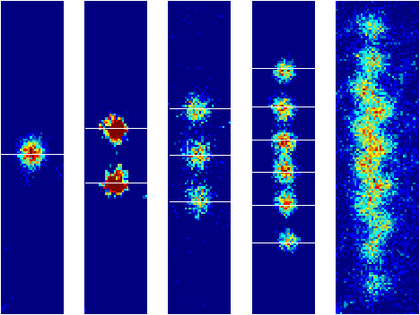
PHYC30020 Quantum Systems
Andy McCulloch

Slide 2
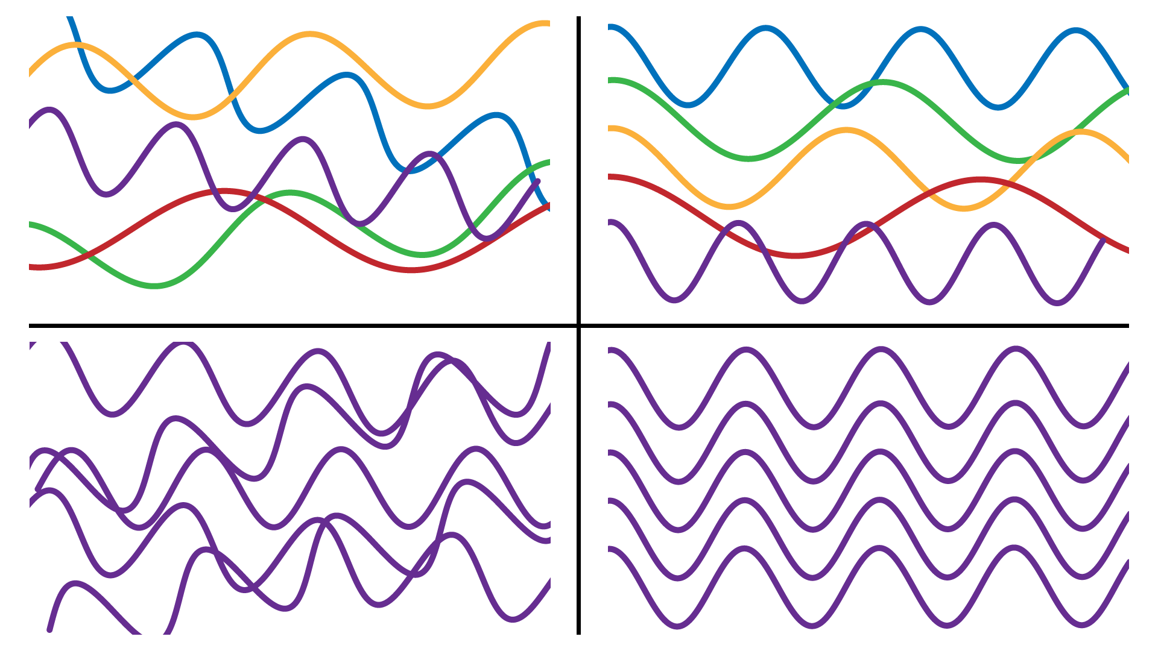
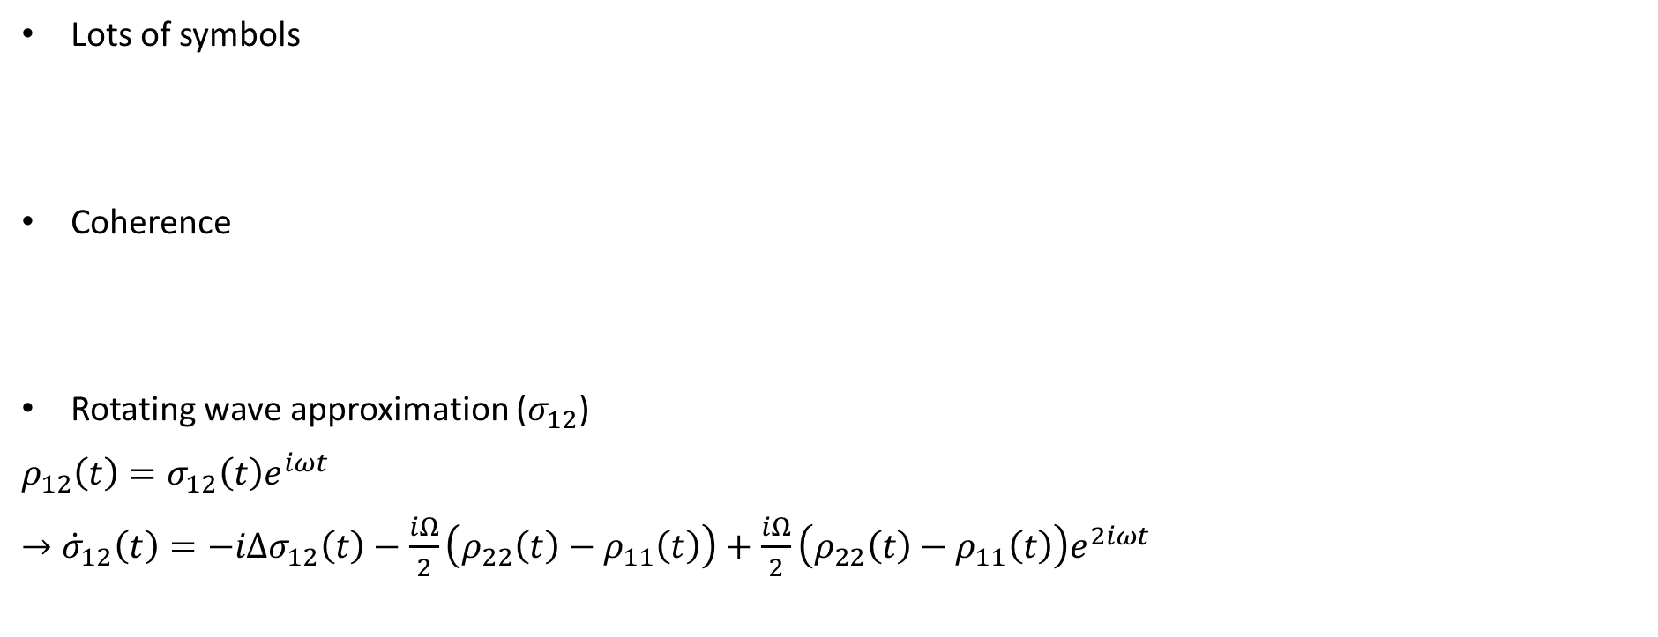
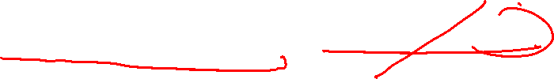
Feedback
Lots of symbols
Coherence
Rotating wave approximation ($σ_{12}$)
$ρ_{12}\left(t\right)=σ_{12}\left(t\right)e^{iωt}$
$→{\dot{σ}}_{12}\left(t\right)=−iΔσ_{12}\left(t\right)−\frac{iΩ}{2}\left(ρ_{22}\left(t\right)−ρ_{11}\left(t\right)\right)+\frac{iΩ}{2}\left(ρ_{22}\left(t\right)−ρ_{11}\left(t\right)\right)e^{2iωt}$

Slide 3
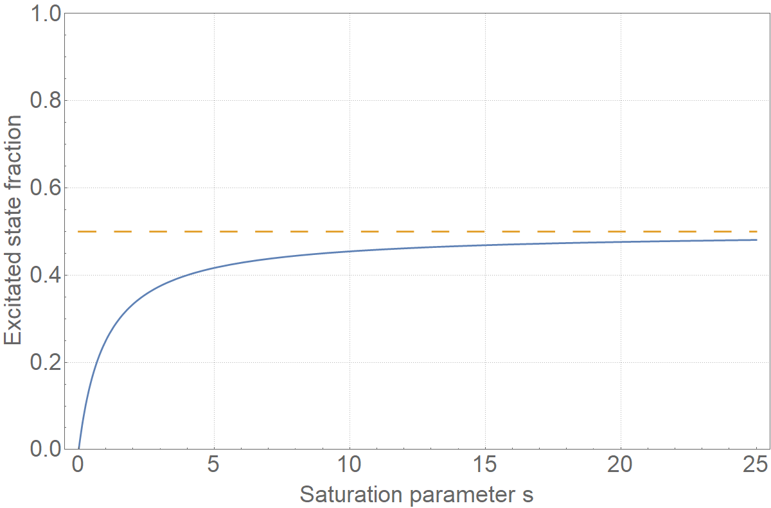
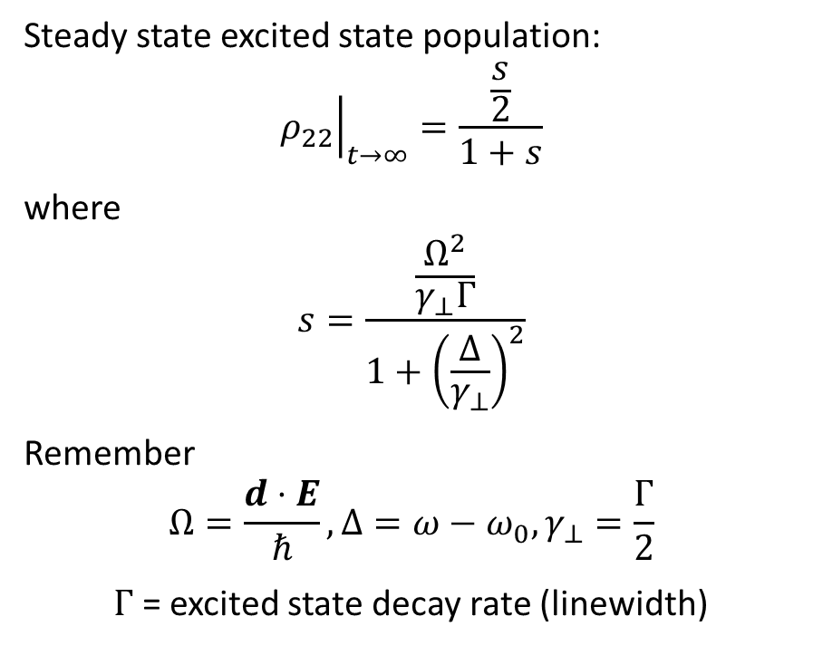
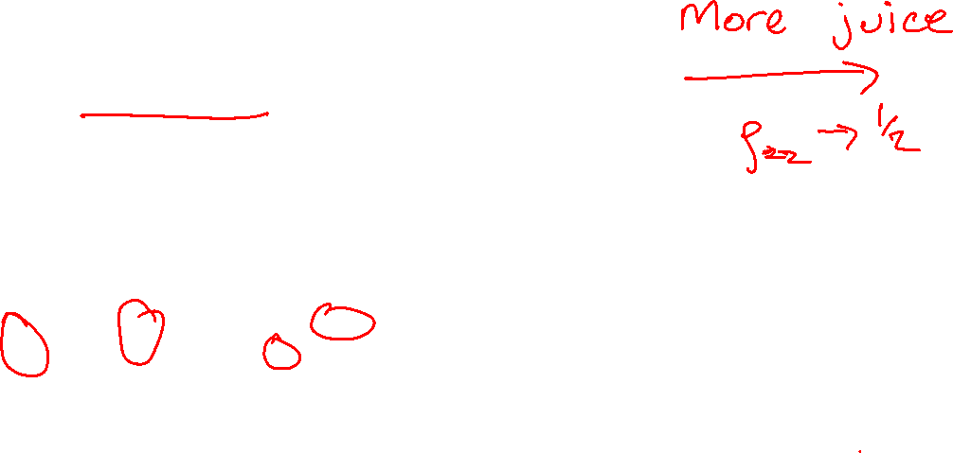
Saturation
Steady state excited state population:
$${\left.ρ_{22}\right|}_{t→∞}=\frac{\frac{s}{2}}{1+s}$$
where
$$s=\frac{\frac{Ω^{2}}{γ_{⊥}Γ}}{1+{\left(\frac{Δ}{γ_{⊥}}\right)}^{2}}$$
Remember
$$Ω=\frac{d⋅E}{ℏ},Δ=ω−ω_{0}, γ_{⊥}=\frac{Γ}{2}$$
$Γ$= excited state decay rate (linewidth)

Slide 4
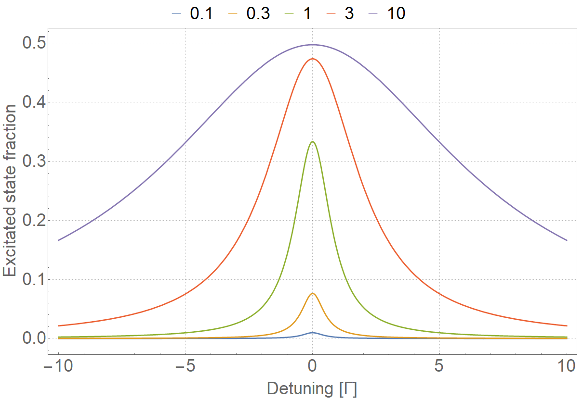
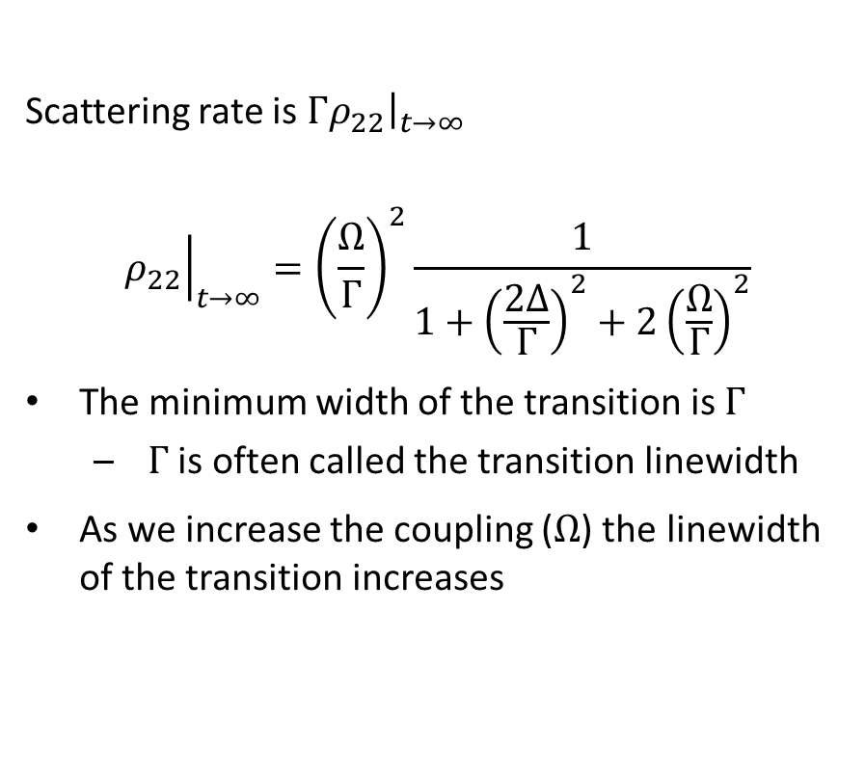
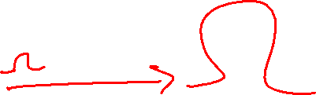
Saturation broadening
Scattering rate is ${\left.{Γρ}_{22}\right|}_{t→∞}$
$${\left.ρ_{22}\right|}_{t→∞}={\left(\frac{Ω}{Γ}\right)}^{2}\frac{1}{1+{\left(\frac{2Δ}{Γ}\right)}^{2}+2{\left(\frac{Ω}{Γ}\right)}^{2}}$$
The minimum width of the transition is $Γ$
$Γ$ is often called the transition linewidth
As we increase the coupling ($Ω$) the linewidth of the transition increases

Slide 5
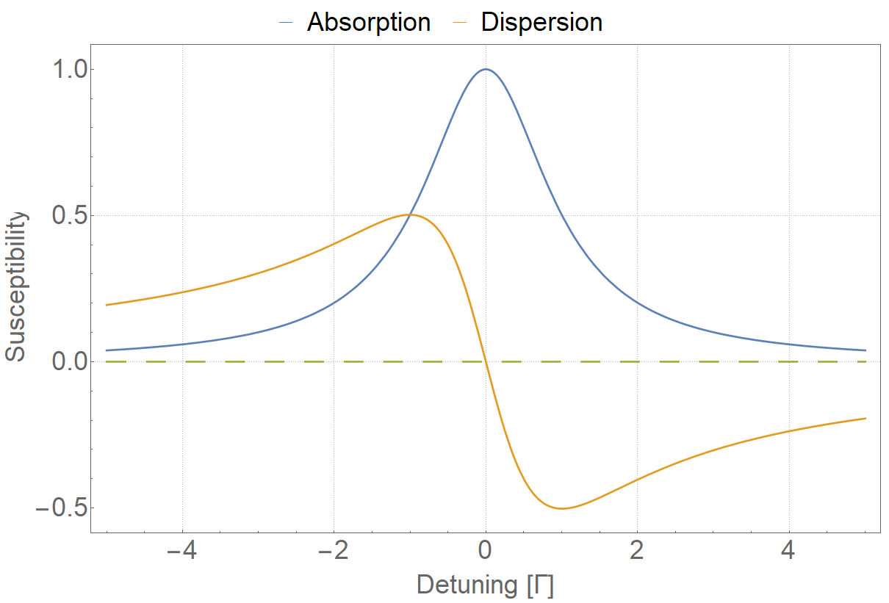

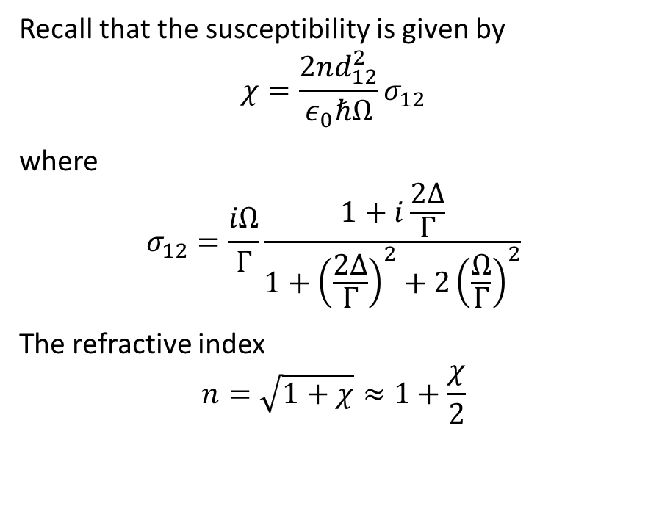

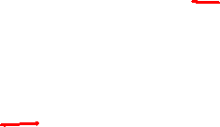
Susceptibility
Recall that the susceptibility is given by
$$χ=\frac{2nd_{12}^{2}}{ε_{0}ℏΩ}σ_{12}$$
where
$$σ_{12}=\frac{iΩ}{Γ}\frac{1+i\frac{2Δ}{Γ}}{1+{\left(\frac{2Δ}{Γ}\right)}^{2}+2{\left(\frac{Ω}{Γ}\right)}^{2}}$$
The refractive index
$$n=\sqrt{1+χ}≈1+\frac{χ}{2}$$

Slide 6
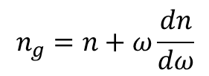
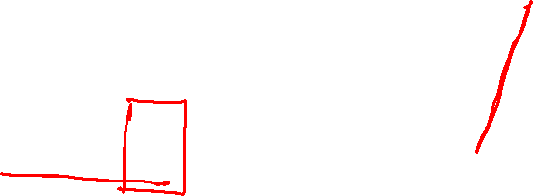
Slow light
$$n_{g}=n+ω\frac{dn}{dω}$$

Slide 7
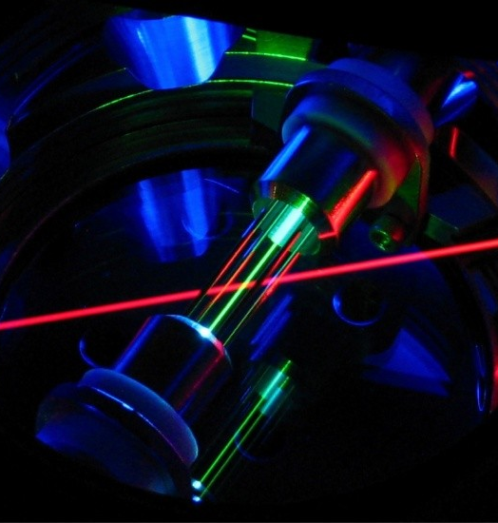
Transient effects

Slide 8
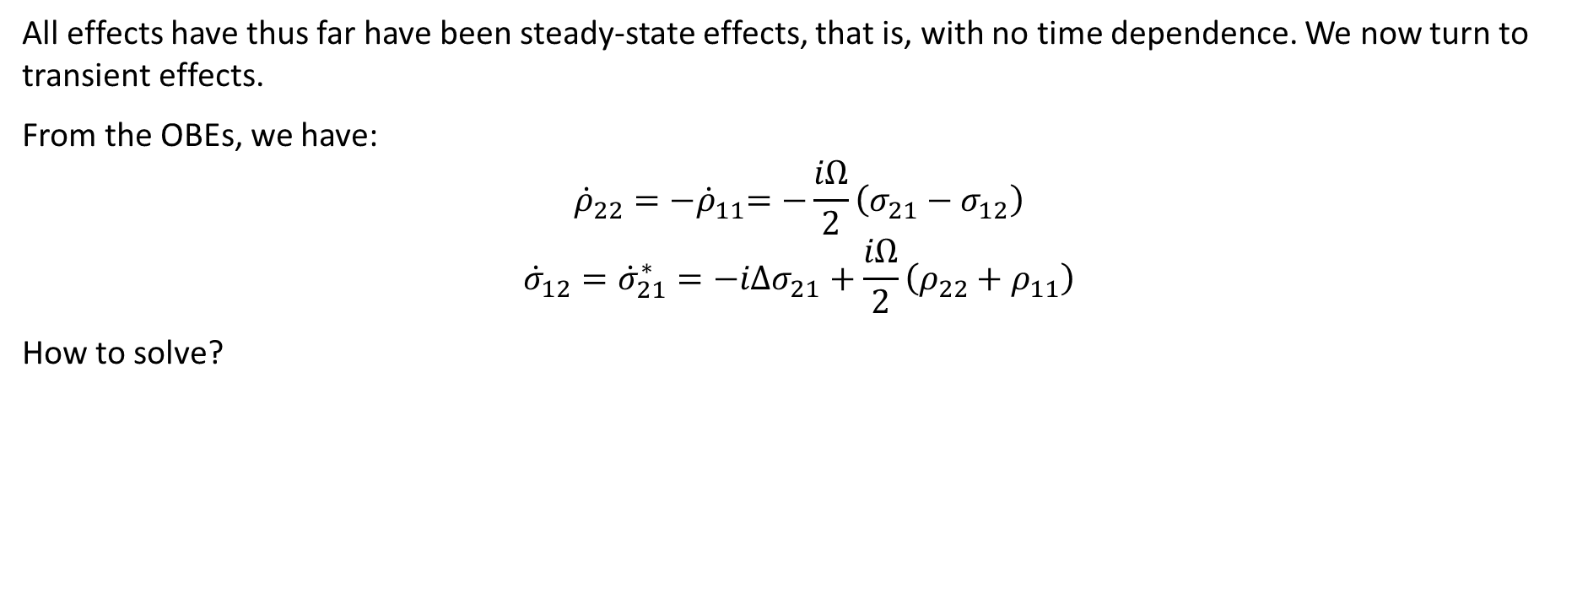
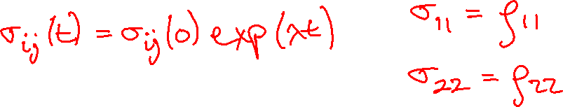
Solving the OBEs (1)
All effects have thus far have been steady-state effects, that is, with no time dependence. We now turn to transient effects.
From the OBEs, we have:
$${\dot{ρ}}_{22}={−\dot{ρ}}_{11}=−\frac{iΩ}{2}\left(σ_{21}−σ_{12}\right)$$
$${\dot{σ}}_{12}={\dot{σ}}_{21}^{∗}=−iΔσ_{21}+\frac{iΩ}{2}\left(ρ_{22}+ρ_{11}\right)$$
How to solve?

Slide 9
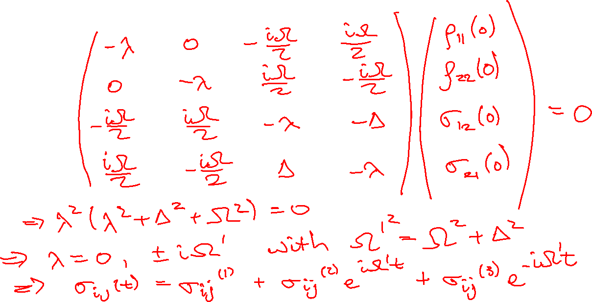
Solving the OBEs (2)

Slide 10
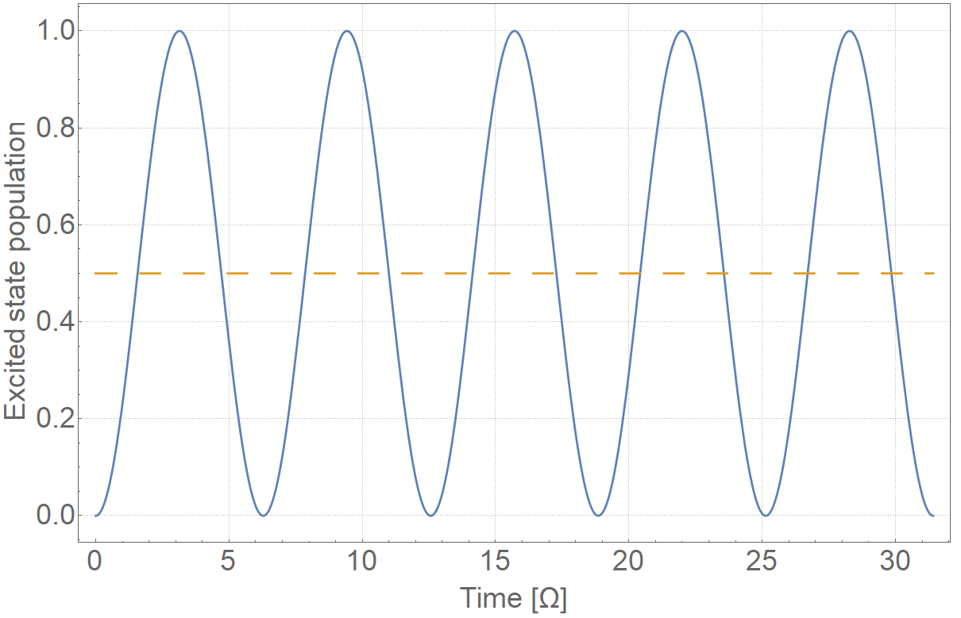
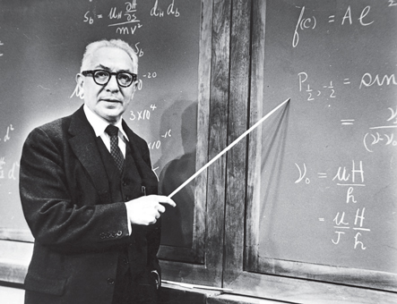
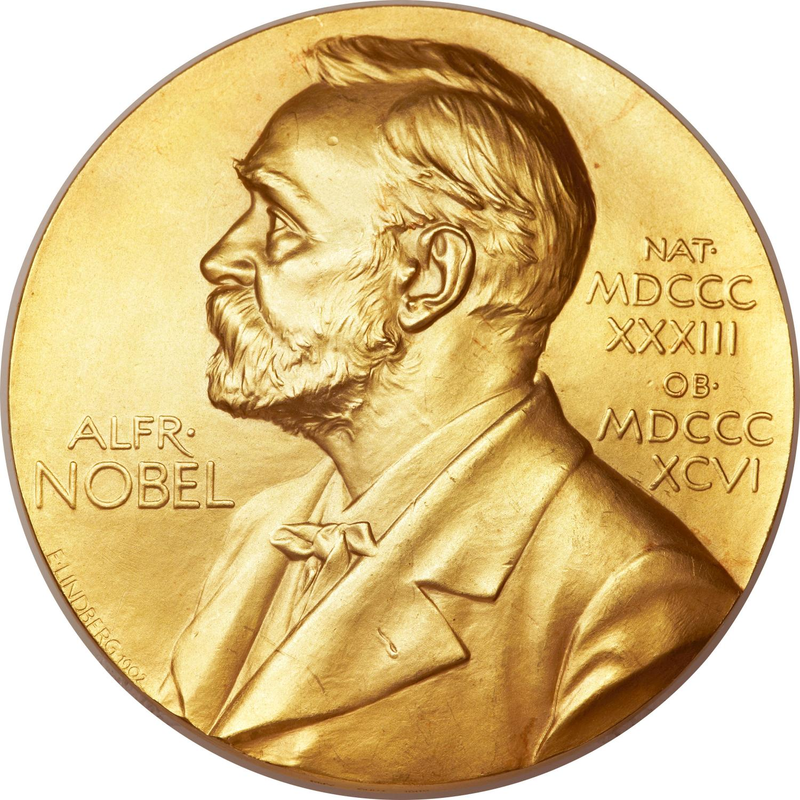
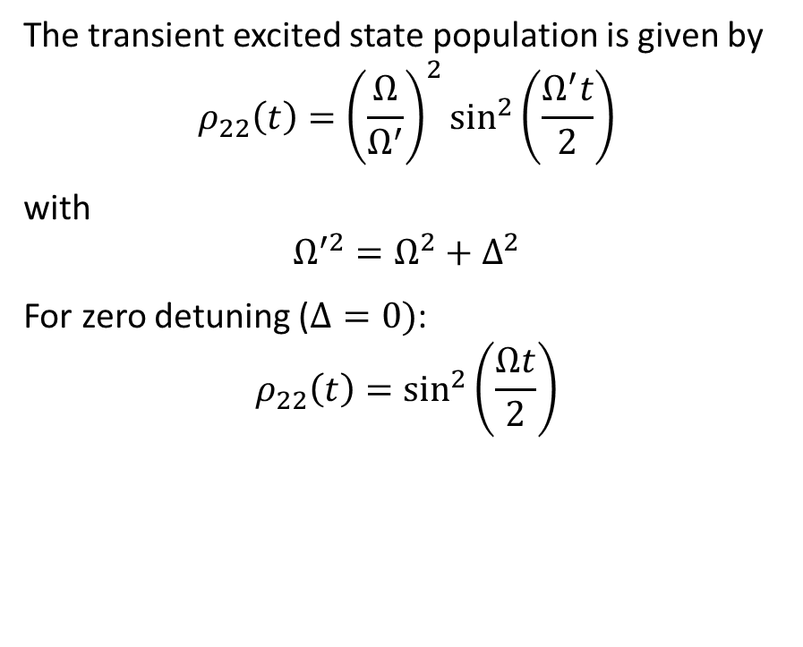
Rabi oscillations
The transient excited state population is given by
$$ρ_{22}\left(t\right)={\left(\frac{Ω}{Ω^{′}}\right)}^{2}\sin^{2}\left(\frac{Ω^{′}t}{2}\right)$$
with
$$Ω^{′2}=Ω^{2}+Δ^{2}$$
For zero detuning ($Δ=0)$:
$$ρ_{22}\left(t\right)=\sin^{2}\left(\frac{Ωt}{2}\right)$$
Isidor Isaac Rabi

Slide 11
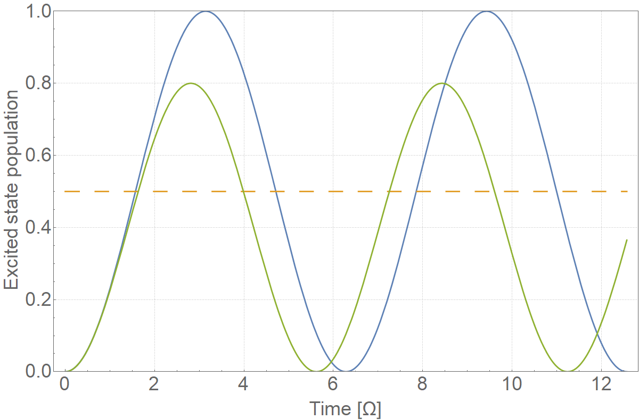
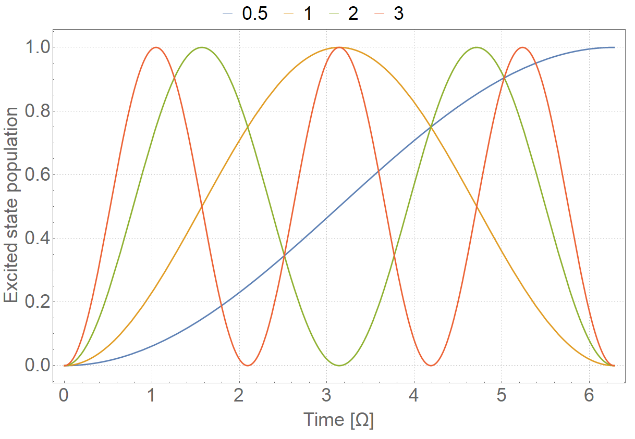
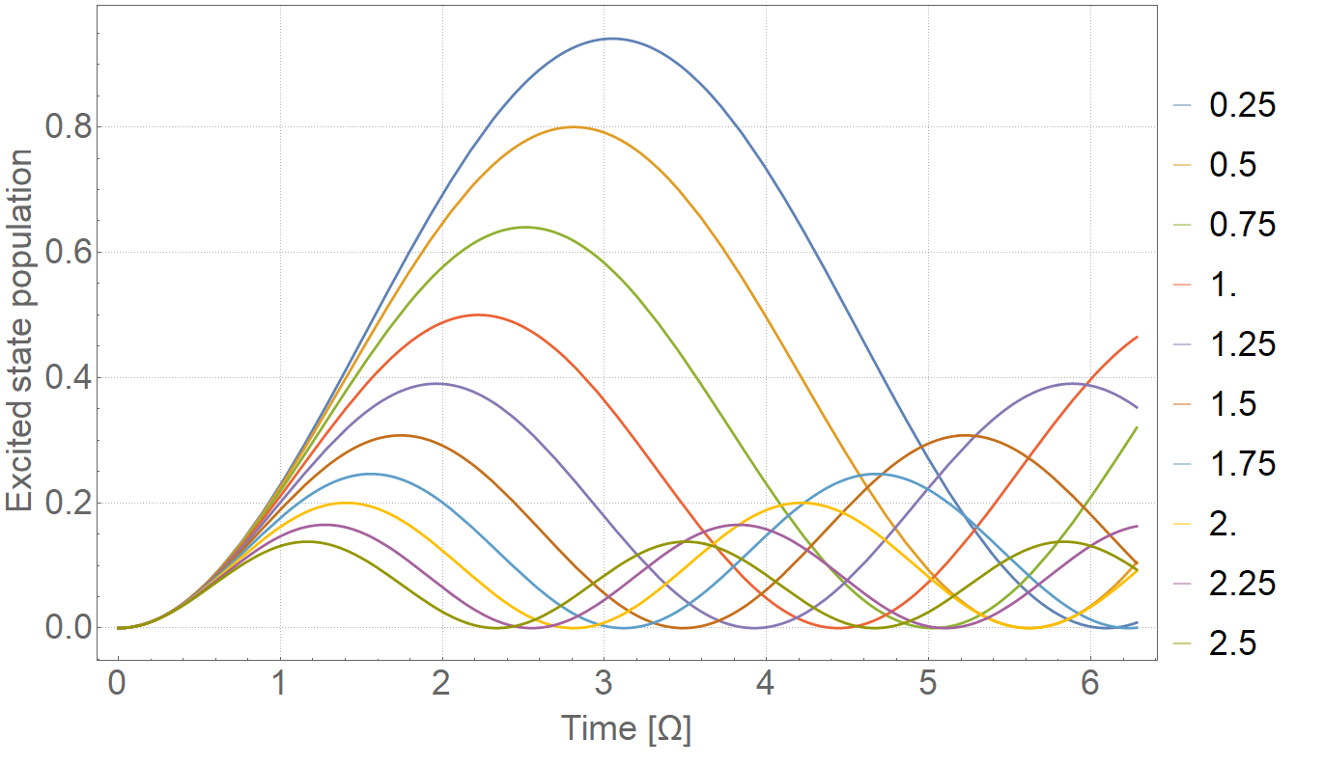
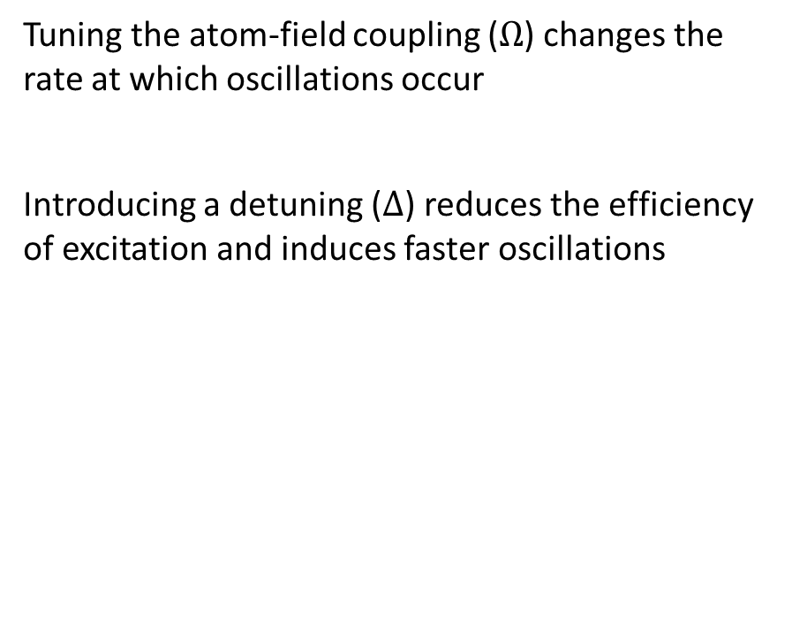
Tuning the oscillations
Tuning the atom-field coupling ($Ω$) changes the rate at which oscillations occur
Introducing a detuning ($Δ$) reduces the efficiency of excitation and induces faster oscillations

Slide 12
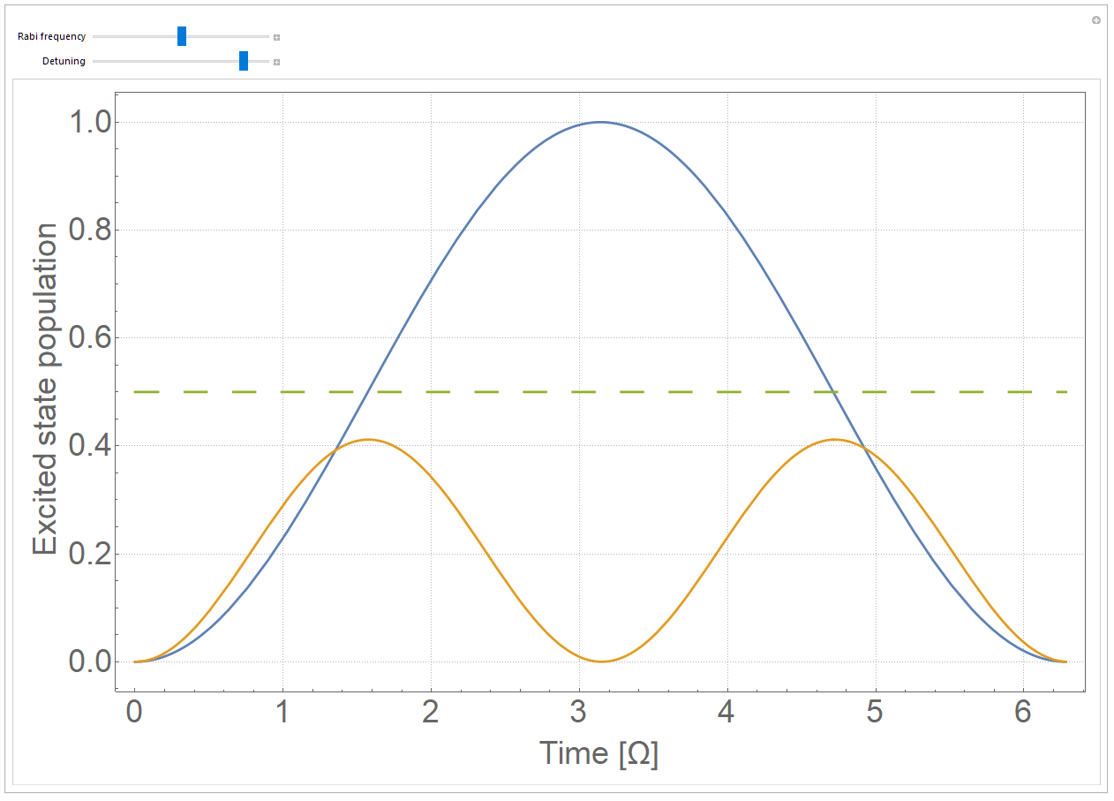
Tuning the oscillations (DIY)

Slide 13
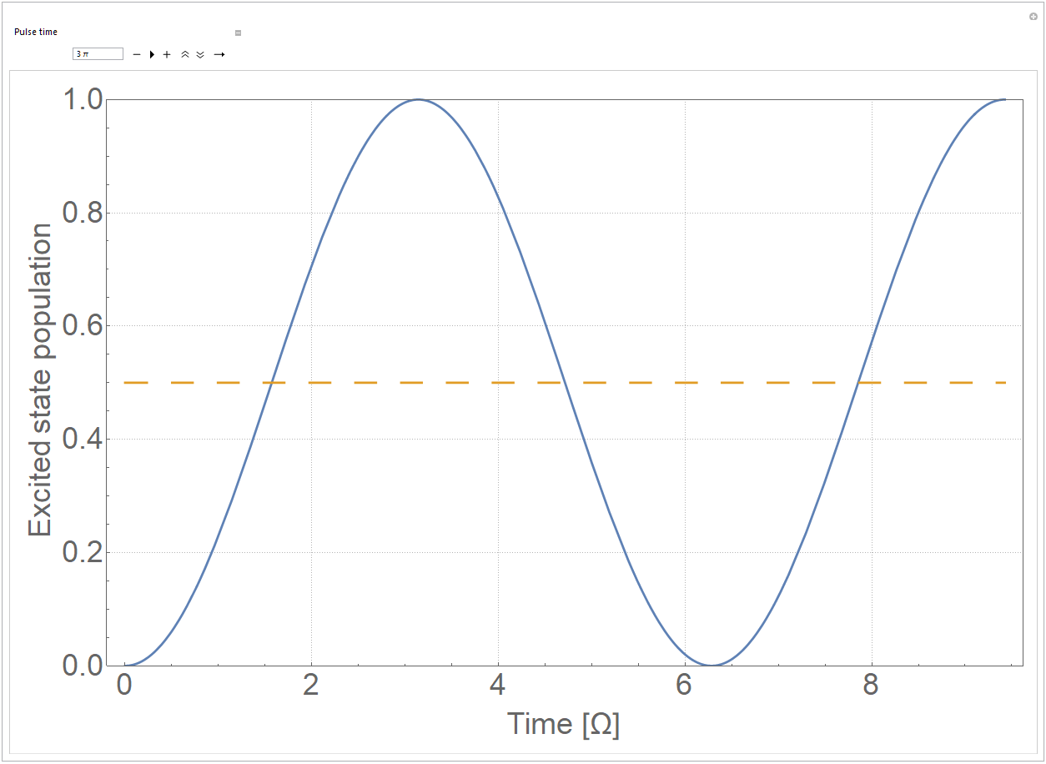
Tuning pulse duration (DIY)

Slide 14
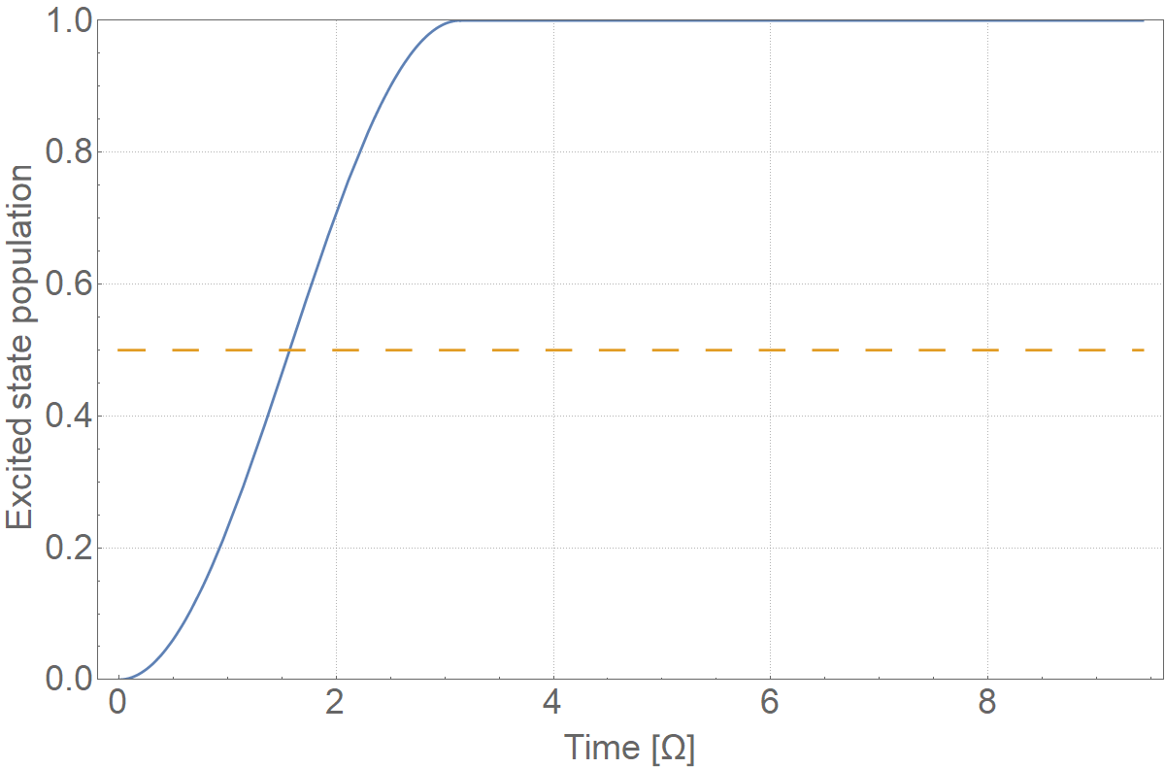
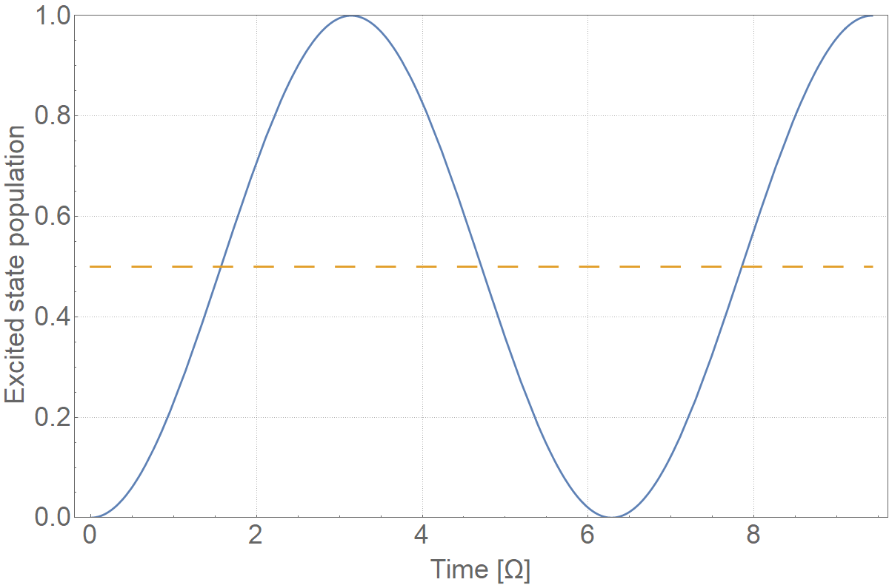
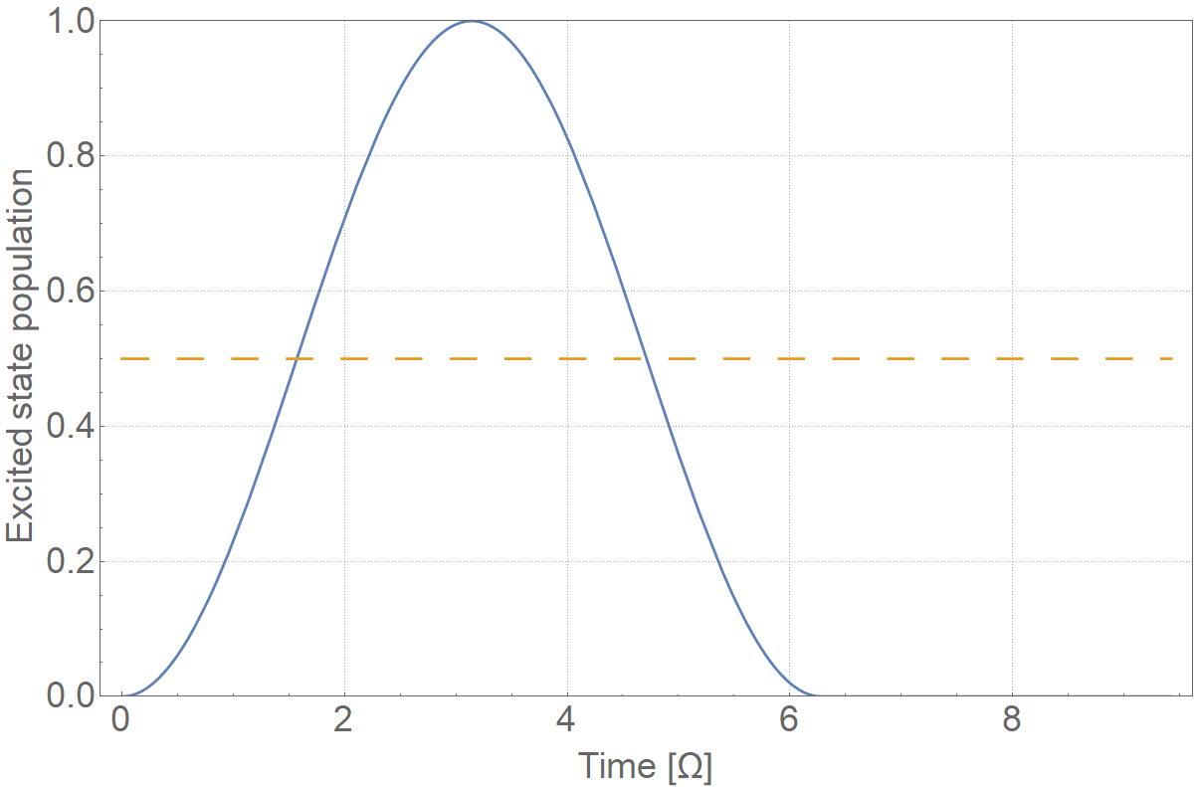
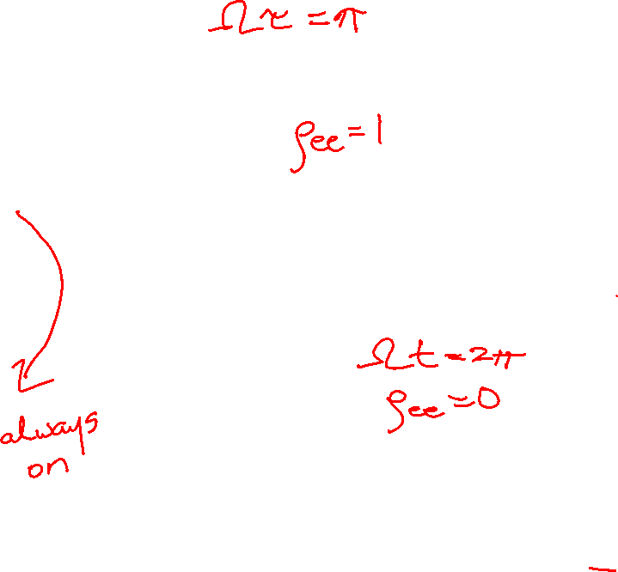
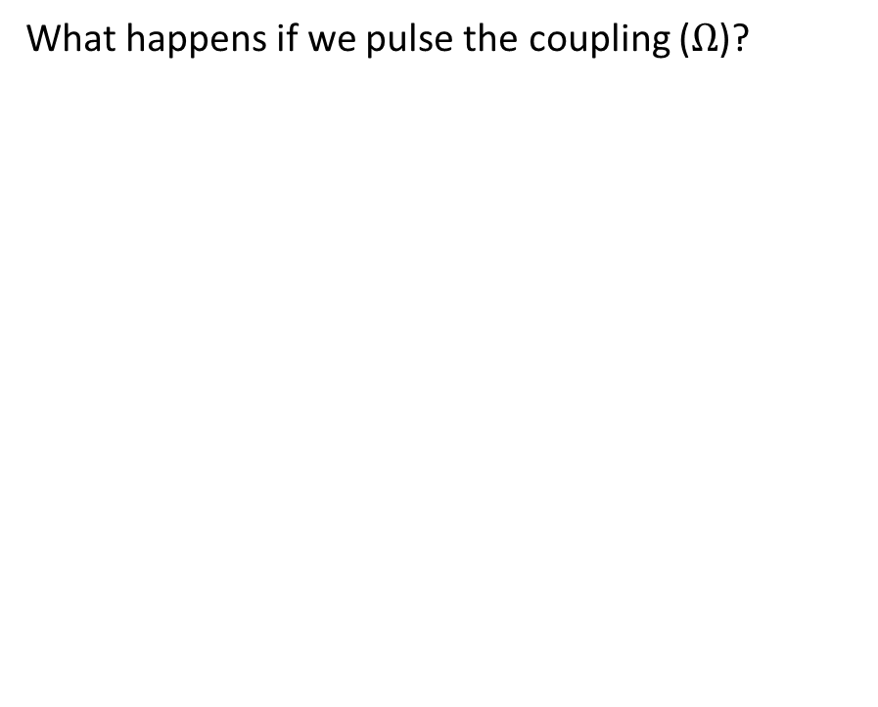
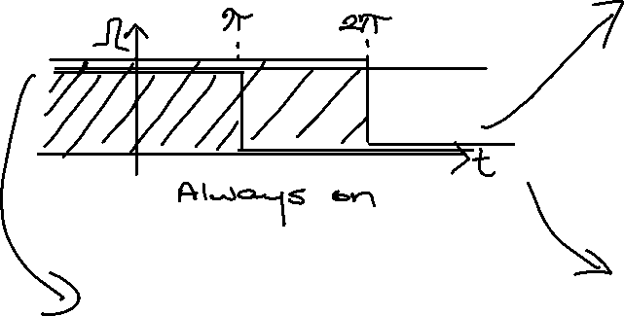
Tuning pulse duration
What happens if we pulse the coupling ($Ω$)?

Slide 15
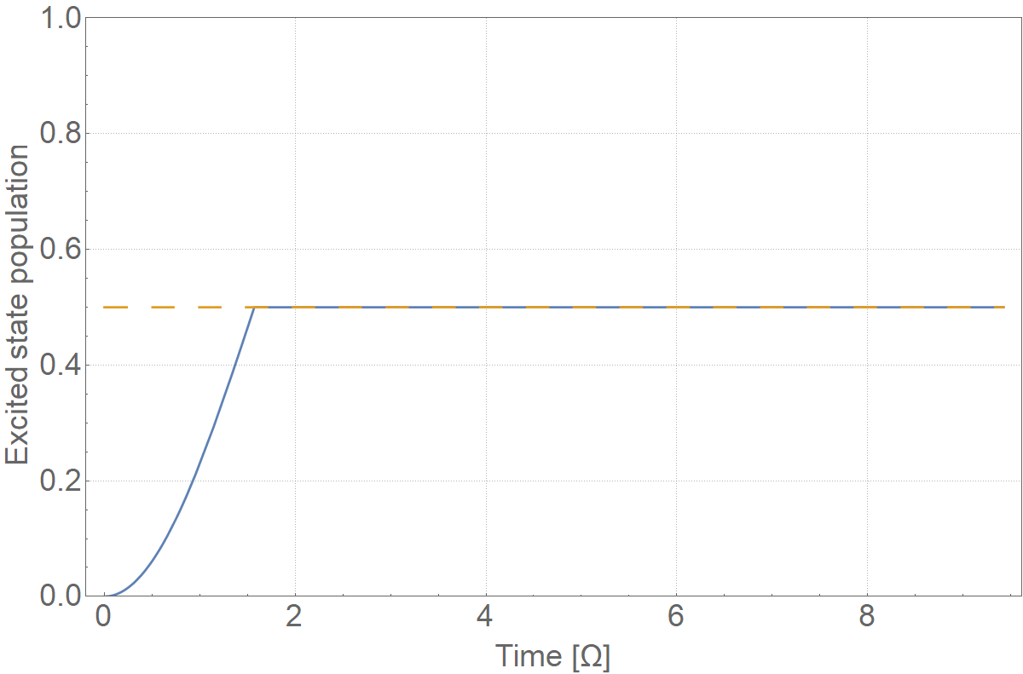
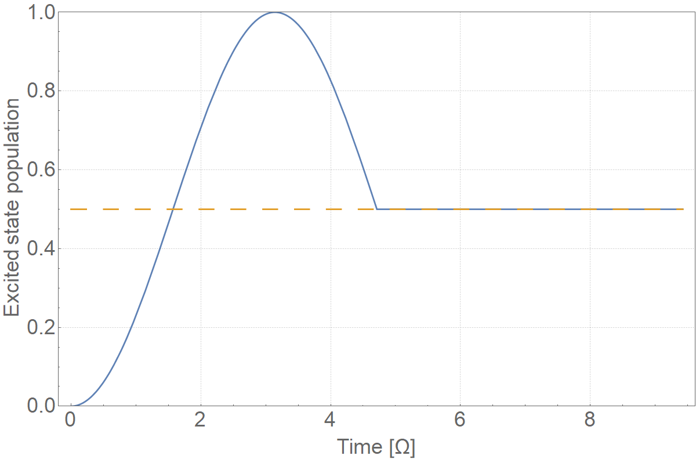
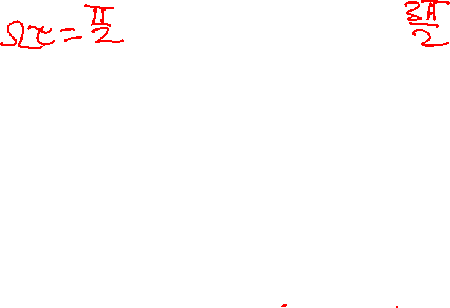
Creating superpositions

Slide 16
Nitrogen vacancy centre Rabi oscillation

Slide 18
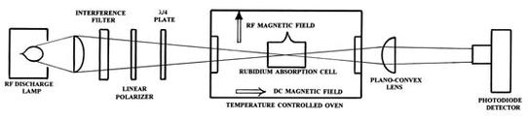
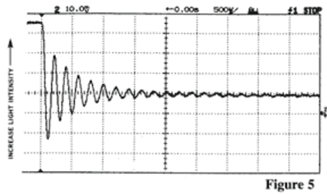
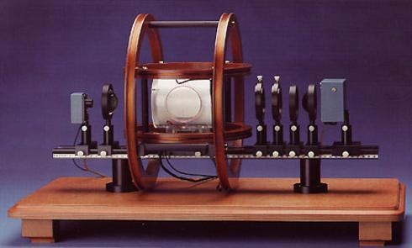
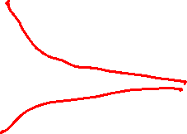
Third year labs: Rabi oscillations in atomic vapour

Slide 19
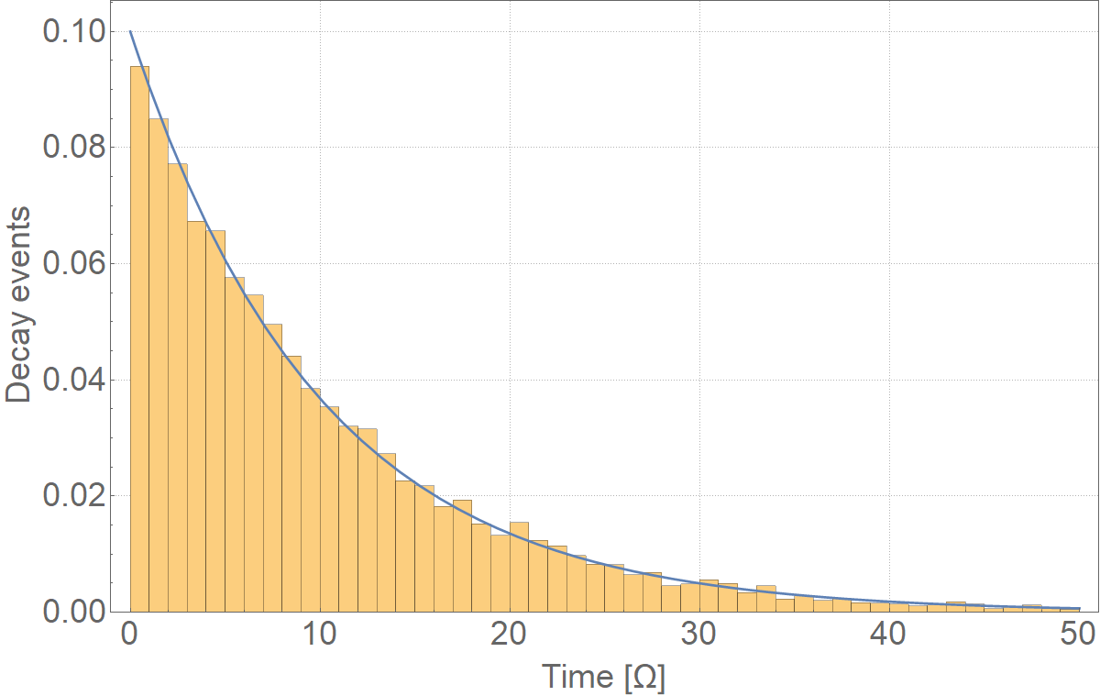
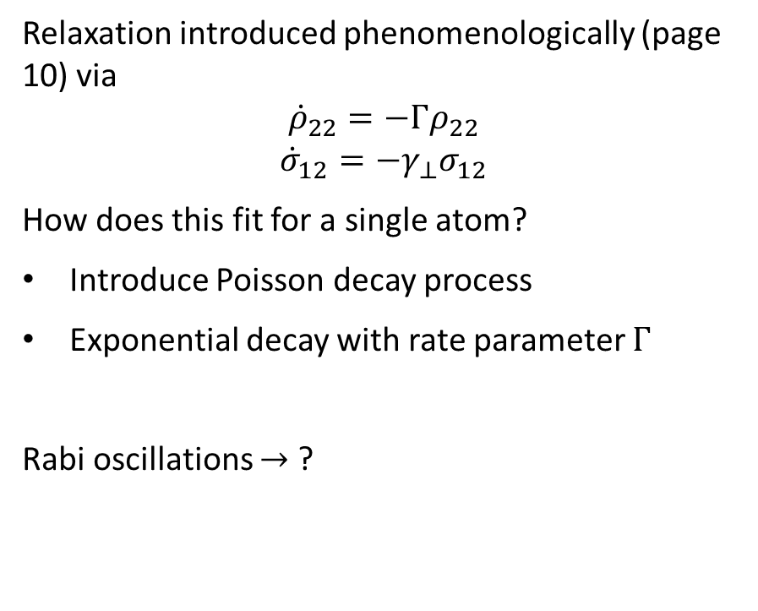
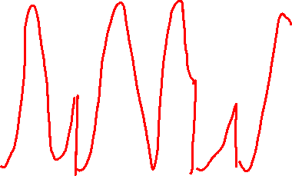
What about damping?
Relaxation introduced phenomenologically (page 10) via
$${\dot{ρ}}_{22}=−Γρ_{22}$$
$${\dot{σ}}_{12}=−γ_{⊥}σ_{12}$$
How does this fit for a single atom?
Introduce Poisson decay process
Exponential decay with rate parameter $Γ$
Rabi oscillations $→$ ?

Slide 20
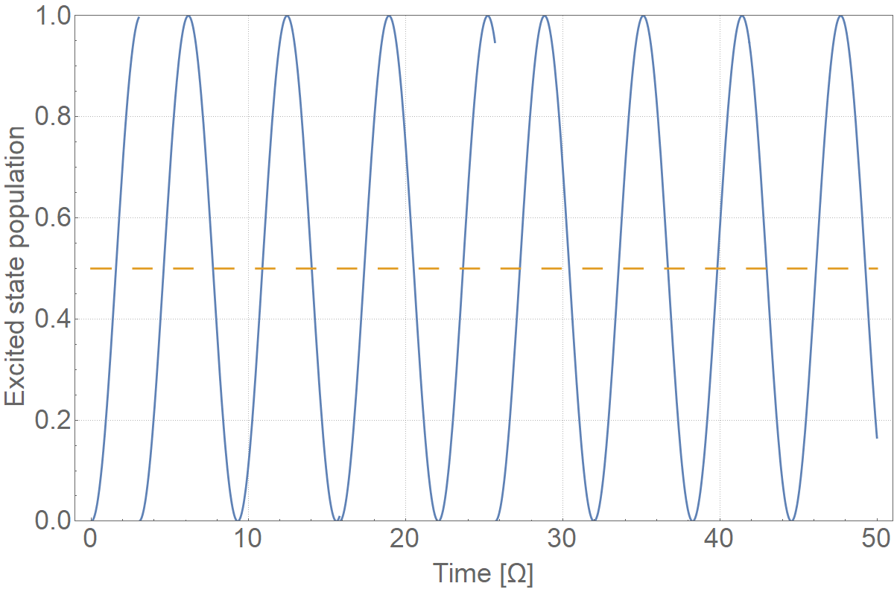
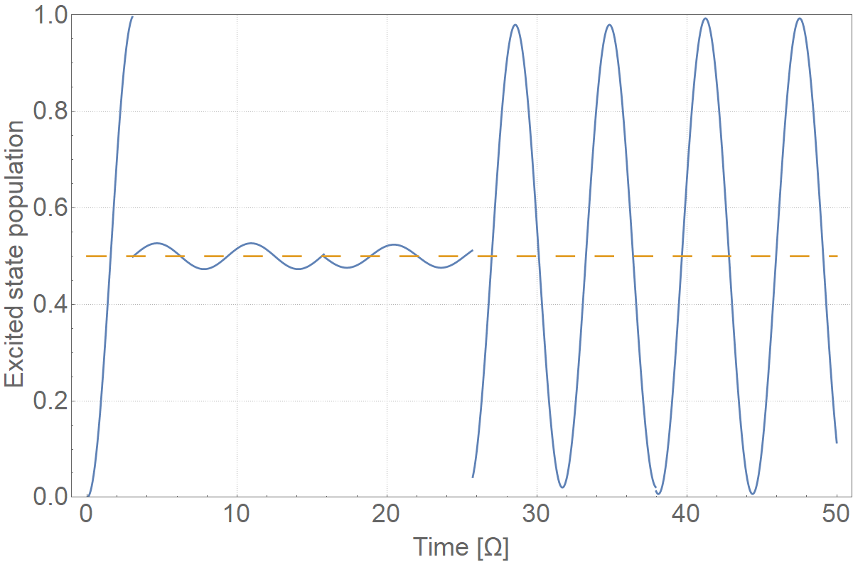
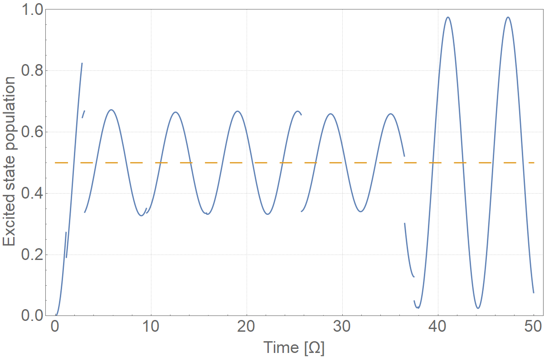
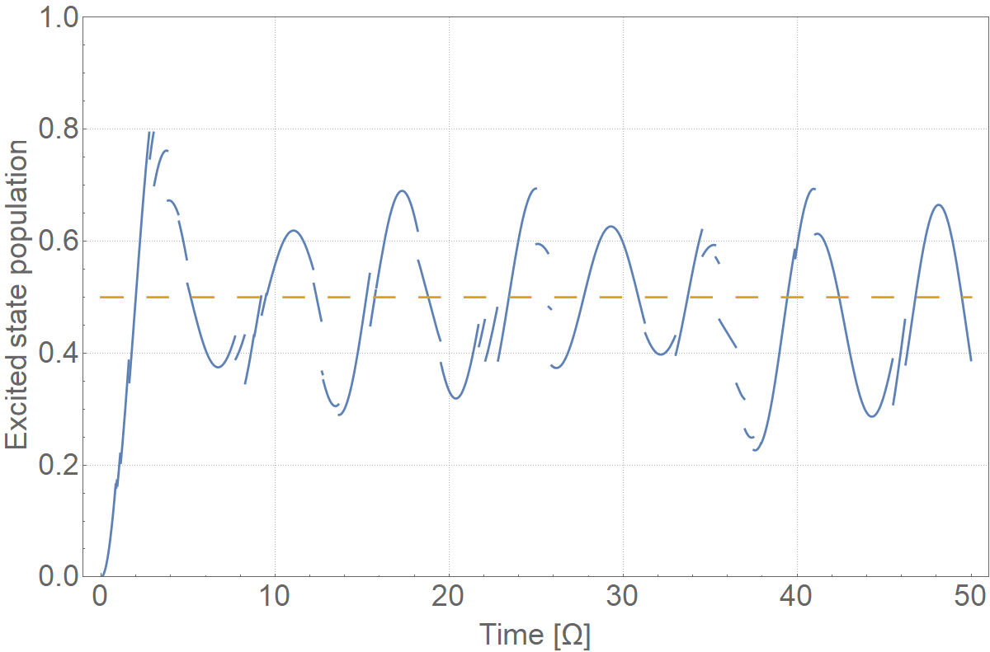
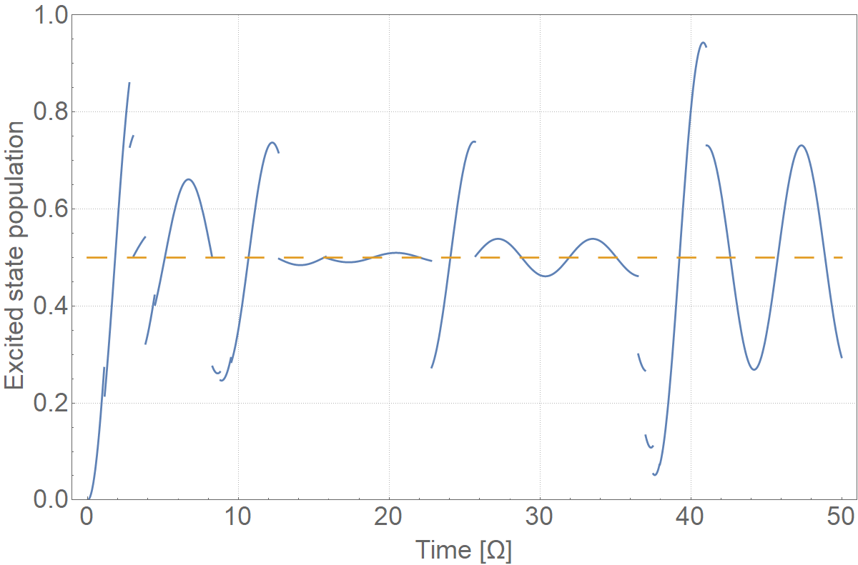


Decay with ensembles (1)
Notes:
N=1,2,3,4,5,10

Slide 21




Decay with ensembles (2)
Solve OBEs numerically and compare:
Compare with
Notes:
N=25,50 and 100

Slide 22

The Bloch sphere

Slide 23











The Bloch vector (1)
Consider the Pauli matrices

Slide 24





















The Bloch vector (2)
Then

Slide 25



The Bloch vector (3)
Which leads to the equations of motion
$${\dot{ρ}}_{22}={−\dot{ρ}}_{11}=−\frac{iΩ}{2}\left(σ_{21}−σ_{12}\right)$$
$${\dot{σ}}_{12}={\dot{σ}}_{21}^{∗}=−iΔσ_{21}+\frac{iΩ}{2}\left(ρ_{22}+ρ_{11}\right)$$

Slide 26



The Bloch vector (4)
For a pure state, $σ_{21}σ_{12}=ρ_{22}ρ_{11}$.
Let’s calculate the length of the Bloch vector:

Slide 27

Meaning of the Bloch vector (1)

Slide 28






Meaning of the Bloch vector (2)
Recall
$$d=\left(\begin{matrix}0 & d_{12} \\ d_{21} & 0\end{matrix}\right)$$
So
$$\sin\left(x+φ\right)=\sin\left(x\right)\cos\left(φ\right)+\sin\left(x+\frac{π}{2}\right)\sin\left(φ\right)$$

Slide 29

Meaning of the Bloch vector (3)
$\left\langle σ_{z}\right\rangle =w$ is the degree of atomic excitation
$\left(\begin{matrix}\left\langle σ_{x}\right\rangle \\ \left\langle σ_{y}\right\rangle \end{matrix}\right)=\left(\begin{matrix}u \\ v\end{matrix}\right)$ are the components of $⟨\hat{d}⟩$ which oscillate in phase and quadrature with the coupling field.
$→$ Only a dipole moment when the atom is a superposition of$\left|1\right\rangle$ and $\left|2\right\rangle$ ($d$ is off-diagonal)
Equivalently, the azimuthal angle represents the relative phase of $\left|1\right\rangle$ and $\left|2\right\rangle$

Slide 30

The Bloch sphere (1)
Point on the z-axis?
Point on the sphere?
On-resonant excitation

Slide 31


The Bloch sphere (2)
Equatorial evolution
Off-resonant excitation

Slide 32


Relaxation
Recall
$${\dot{ρ}}_{22}=−Γρ_{22}$$
$${\dot{σ}}_{12}=−γ_{⊥}σ_{12}$$
$$Γ=\frac{1}{T_{1}},γ_{⊥}=\frac{1}{T_{2}}$$
What does decay look like?

Slide 33



Frequency measurement
Idea: we want to measure the energy splitting
$→$ long interaction times required for small energy splitting
$→$ Need sharp resonance peak

Slide 34




The Ramsey method
Method of separated oscillatory fields
$Δ≪Ω$ (rotation around $x$-axis)
Interaction time $τ=$ spot size/beam velocity $=l/v$
Tune $Ω′$ such that $Ω′τ=\frac{π}{2}$
Procession occurs for time $T=\frac{L}{v}$ at a rate of $Δ$
Measure $ρ_{22}$
Vary the distance L
Norman Ramsey

Slide 35


Ramsey interferometry

Slide 36



Ramsey fringes
$$\frac{ω_{0}}{δω}$$
$$ρ_{ee}=\cos^{2}\left(\frac{ΔL}{2v}\right)$$

Slide 37

Modern frequency standards
See November for the redefinition of SI units!

Slide 38


Magnetic resonance (1)
Consider a spin-1/2 system in a magnetic field $B$
The interaction component of the Hamiltonian is given by
$${\hat{H}}^{′}=−\hat{μ}⋅B$$
Where $\hat{μ}$ is the magnetic dipole moment. We consider a static magnetic field oriented along the $z$-axis, so $−\hat{μ}⋅B=−μ_{z}B_{0}$
In the absence of a magnetic field, the states $\left|S_{z};±1/2\right\rangle ≡\left|±\right\rangle$ are degenerate, but this is lifted with a non-zero magnetic field (Zeeman shift)

Slide 39


Magnetic resonance (2)
$$\hat{μ}=γ\hat{S}$$
$$→μ_{z}=γ\frac{ℏ}{2}$$
Hence the energy is
$$E=−μ_{z}B_{0}=−γ\frac{ℏ}{2}B_{0}$$
$$→ΔE=γℏB_{0}$$

Slide 40




Expectation values
Let’s compute $\left\langle {\hat{S}}_{x}\right\rangle ,\left\langle {\hat{S}}_{y}\right\rangle and\left\langle {\hat{S}}_{z}\right\rangle :$
$\left\langle {\hat{S}}_{z}\right\rangle$
$\left\langle {\hat{S}}_{x}\right\rangle$
The time evolution of $ρ$ is given by the Liouville-von Neumann equation:
$$iℏ\frac{dρ}{dt}=−\left[ρ,H\right]$$
$$\left|ψ(t)\right\rangle =e^{−\frac{iEt}{ℏ}}\left|ψ\left(0\right)\right\rangle$$

Slide 41



Precession and magnetisation
The spin vector undergoes precession around the magnetic ($z$) axis with frequency $ω_{0}=γB_{0}$, known as the Larmor frequency
The magnetisation of the system is the total magnetic dipole moment (per unit volume) and is proportional to $\left\langle {\hat{S}}_{z}\right\rangle$
Joseph Larmor

Slide 42




State coupling
Introduce a coupling field between $\left|+\right\rangle$ and $\left|−\right\rangle$
This is a 2-level system as seen previously
What is different about the coupling field?
$$Δl=±1, Δm=0,±1, Δs=0$$
$$ΔJ=0,±1, ΔM_{j}=0,±1$$
Require a (nuclear) non-zero spin
$→$Non-zero nuclear spin ($I≠0)$
$I=1/2$: ¹H, ³H, ¹³C, ¹⁵N, …

Slide 43



Chemical shift (1)
Molecules experience a shift in resonance peak depending on atomic arrangement (isomers, conformation)
Shielding/exposure of nucleus due to electronegativity
Anisotropy due to $π$-bonded electrons generating $B$ field

Slide 44


Chemical shift (2)

Slide 45




NMR apparatus
All the same, just bigger magnets
3rd year labs: 0.5 T
Bio21: >20 T

Slide 46




Precession in $x−y$
Suppose that we have $ρ_{++}=1$ and we put in a $\frac{π}{2}$ pulse. Now the magnetisation is in the $x−y$ plane, undergoing precession at rate $ω_{0}$
Precession occurs at a rate $ω_{0}$ regardless of where on the Bloch sphere we are.
Measure signal in our pickup coil

Slide 47







Pulse sequences (1)
Want the most accurate value of $ω_{0}$
Use Ramsey interferometry?
Does not work well with inhomogeneous broadening
But let’s try!
$$ρ_{++}=1$$
$$\frac{π}{2}$$
$$T$$
$$\frac{π}{2}$$

Slide 48







Pulse sequences (2)
$$\left|+\right\rangle$$
$$\frac{π}{2}$$
$$T$$
$$π$$
$$T$$

Slide 49



Spin echo (1)
Notes:
Spin echo

Slide 50



Spin echo (2)

Slide 51






Relaxation: T1 and T2

Slide 52



Probing the local environment
Perform pulse sequences to find T1 and T2 for ensemble
Different environments have different T1 and T2
What about spatial information?
Do NMR in a local environment and raster scan:

Slide 53


Imaging with NMR
Introduce a field gradient
Different Larmor frequencies
What does this mean for excitation?
Precession rates only depend on $\left|B\right|$
Signal quickly becomes a mess. How can be separate frequencies?

Slide 54




(N)MRI
Add tomography, shake and stir…

Slide 55

The light shift

Slide 56



Energy eigenstates
All of the physics here has been built upon the two level system:
$\left|1\right\rangle$ and $\left|2\right\rangle$ are eigenstates of ${\hat{H}}_{A}={\hat{H}}_{0}$
Are they eigenstates of ${\hat{H}}_{A}+{\hat{H}}_{I}$?
Consider a pure state
$$\left|ψ\right\rangle =c_{1}\left|1\right\rangle +c_{2}\left|2\right\rangle$$
We know this gives
$$\frac{dc_{1}}{dt}=−i\frac{Ω}{2}c_{2}e^{iωt}$$
$$\frac{dc_{2}}{dt}=iω_{0}c_{2}−i\frac{Ω}{2}c_{1}e^{−iωt}$$
RWA $→{\tilde{c}}_{2}≔c_{2}e^{iωt}$
$$\frac{d}{dt}\left(\begin{matrix}{\tilde{c}}_{2} \\ c_{1}\end{matrix}\right)=−i\left(\begin{matrix}−Δ & \frac{Ω}{2} \\ \frac{Ω}{2} & 0\end{matrix}\right)\left(\begin{matrix}{\tilde{c}}_{2} \\ c_{1}\end{matrix}\right)=−\frac{i}{ℏ}\tilde{H}\left(\begin{matrix}{\tilde{c}}_{2} \\ c_{1}\end{matrix}\right)$$

Slide 57




Energy eigenstates
Then
$$\tilde{H}=ℏ\left(\begin{matrix}−Δ & \frac{Ω}{2} \\ \frac{Ω}{2} & 0\end{matrix}\right)$$
The eigenvalues of this are given by
$$E_{±}=−\frac{ℏΔ}{2}±\frac{ℏΩ′}{2}$$
with corresponding eigenvectors
$$\left|+\right\rangle =\sin{θ}\left|1\right\rangle +\cos{θ}\left|2\right\rangle$$
$$\left|−\right\rangle =\cos{θ}\left|1\right\rangle −\sin{θ}\left|2\right\rangle$$
and the Stückelberg angle $θ$
$$\tan{2θ}=−\frac{Ω}{Δ} \left(0≤θ<\frac{π}{2}\right)$$
In the uncoupled case:

Slide 58


Landau-Zener crossings (1)
What happens with a coupling?
Identify uncoupled eigenstates for large $Δ$
The coupling lifts the degeneracy at $Δ=0$ and introduces an avoided crossing.
For atoms coupled to light fields, this shift is called the AC Stark shift
The states arising combined light/atom Hamiltonians are often called dressed states

Slide 59


Landau-Zener crossings (2)
Appear everywhere in physics
Coupling between excited states of Rb in an electric field:
$$\hat{H}={\hat{H}}_{0}+F\hat{z}$$

Slide 60



Adiabatic passage (1)
Suppose you want to transfer the population from$\left|1\right\rangle$ to $\left|2\right\rangle$ with high efficiency
Use Rabi: $π$-pulse?
The dressed states provide a way for population transfer with near-unity probability
Slowly sweep the coupling to transfer to population to between uncoupled eigenstates
How to do experimentally?
What does it mean to go from $\left|−\right\rangle$ to $\left|+\right\rangle$?
How fast is too fast?

Slide 61


Adiabatic passage (2)
Chirping the field: $ω→ω(t)$
RWA:
$$e^{−iωt}→\exp\left[−i\int_{0}^{t}{ω\left(t^{′}\right)dt^{′}}\right]$$
So
$${\tilde{c}}_{2}=c_{2}\exp\left[i\int_{0}^{t}{ω\left(t^{′}\right)dt^{′}}\right]$$
Then
$$\frac{dc_{1}}{dt}=−i\frac{Ω}{2}{\tilde{c}}_{2}$$
$$\frac{d{\tilde{c}}_{2}}{dt}=iΔ(t){\tilde{c}}_{2}−i\frac{Ω}{2}c_{g}$$
Differentiate and substitute:
$$\left(\frac{d^{2}}{dt^{2}}−iΔ\frac{d}{dt}−i\left(\frac{dΔ}{dt}\right)+\frac{Ω^{2}}{4}\right){\tilde{c}}_{2}=0$$
$$\left(\frac{d^{2}}{dt^{2}}−iΔ\frac{d}{dt}\frac{Ω^{2}}{4}\right)c_{1}=0$$
Transform to another rotating frame
$$c_{1,2}^{′}={\tilde{c}}_{1,2}\exp\left[−\frac{i}{2}\int_{0}^{t}{Δ\left(t^{′}\right)dt^{′}}\right]$$
Assume linear chirp, $Δ\left(t\right)=αt$ $\left(α>0\right)$ and introduce
$$ν=i\frac{Ω^{2}}{4α}, z=e^{−\frac{iπ}{4}}\sqrt{α}t$$

Slide 62


Adiabatic passage (3)
$$\left(\frac{d^{2}}{dt^{2}}+ν+\frac{1}{2}−\frac{z^{2}}{4}\right)c_{2}^{′}=0$$
$$\left(\frac{d^{2}}{dt^{2}}+\left(ν−1\right)+\frac{1}{2}−\frac{z^{2}}{4}\right)c_{1}^{′}=0$$
Solutions are parabolic-cylinder functions $D_{ν}\left(±z\right)$ and $D_{−\left(ν+1\right)}\left(±iz\right)$
It can be shown that
$$c_{2}^{′}∝D_{ν+1}(−iz)$$
And using ${\left.c_{2}^{′}\right|}_{t→∞}=0,{\left.c_{1}^{′}\right|}_{t→∞}=1$
$${\left.{\left|c_{e}^{′}\right|}^{2}\right|}_{t→∞}=1−e^{−2π\left|ν\right|}$$
So finally, the fraction lost during the sweep
$$1−{\left.{\left|c_{e}^{′}\right|}^{2}\right|}_{t→∞}=e^{−2π\left|ν\right|}$$
$$=\exp\left[−\frac{πΩ^{2}}{2\left|α\right|}\right]$$
$$=exp\left[−\frac{πΩ^{2}}{2\left|\frac{dΔ}{dt}\right|}\right]$$
Which is the Landau-Zener result.
What happens when:
$$Ω^{2}≫\left|\frac{dΔ}{dt}\right|,Ω^{2}≪\left|\frac{dΔ}{dt}\right|$$

Slide 63


Adiabatic passage (4)

Slide 64



Rapid adiabatic passage
No decay $(Γ=0)$, we can’t go too slow!
Can be extended to multi-level systems
“Counter-intuitive” pulse sequence
High efficiency transfer – can produce ground state atoms/molecules
Used for “teleportation” with BECs

Slide 65



Rotating wave approximation (1)
In can be shown (to first order) that the shift to the energies of unperturbed states is given a light field is given by
$ΔE_{1}=\frac{ℏΩ^{2}}{4Δ}$ and $ΔE_{2}=−\frac{ℏΩ^{2}}{4Δ}$
Let’s put in the counterrotating term, but as a field with frequency $−ω$. This gives rise to a shift, but with
$$\frac{1}{Δ}=\frac{1}{ω−ω_{0}}→−\frac{1}{ω{+ω}_{0}}$$
Yielding a shift
$${ΔE}_{1,c}=−\frac{ℏΩ^{2}}{4(ω+ω_{0})}$$
Equal and opposite to ${ΔE}_{2,c}$
Putting this all together:
$$Δω=\frac{{ΔE}_{2,c}−{ΔE}_{1,c}}{ℏ}=\frac{Ω^{2}}{2(ω+ω_{0})}$$
So to lowest order, the correction the resonance frequency is given by
$$Δω=\frac{Ω^{2}}{4ω_{0}}$$
Now, orders of magnitude:
$\frac{Ω}{2π}=1$GHz $→2π$-pulse in 1ns
For 1$μ$m light, $Δω=1$kHz
(1 part in ${10}^{−12}$ )

Slide 66


Rotating wave approximation (2)

Slide 67


